Slide 1
HCBDA CAPSTONE PROJECT
Jennifer R. Duschak
Associate Business Data Analyst
November 10, 2023

Slide 2
Data Cleanup Notes and Anomalies:
Initial Data cleanup and ETL:
Data was converted to star schema via ETL process.
Original schema contained 10 tables, was normalized into one fact table and six dimension tables via ETL.
Data discrepancies on Policyholder Birth Date
Initial dataset had PH Birthdate ranging from 1907-2023 giving ages from 0-116.
Reached out to project’s “data engineer” and confirmed this was error in date. Error was corrected.

Slide 3
Data Cleanup Notes and Anomalies:
Accident type had duplicate Vandalism and Collision
Reached out to stakeholder, confirmed duplicate Vandalism was correct.
Wrote custom SQL to clean up Collision for Tableau.
Transformed Gender/Marital Status using custom SQL
Eliminate primary/secondary operator and marital status.
Put neutral category together.
Final categories: Male, Female, Neutral.
Used custom SQL to create a combined view of Age/State/DUI for analysis in Tableau.
Cast Boolean values for DUI, At Fault as integer also using custom SQL within Tableau.

Slide 4
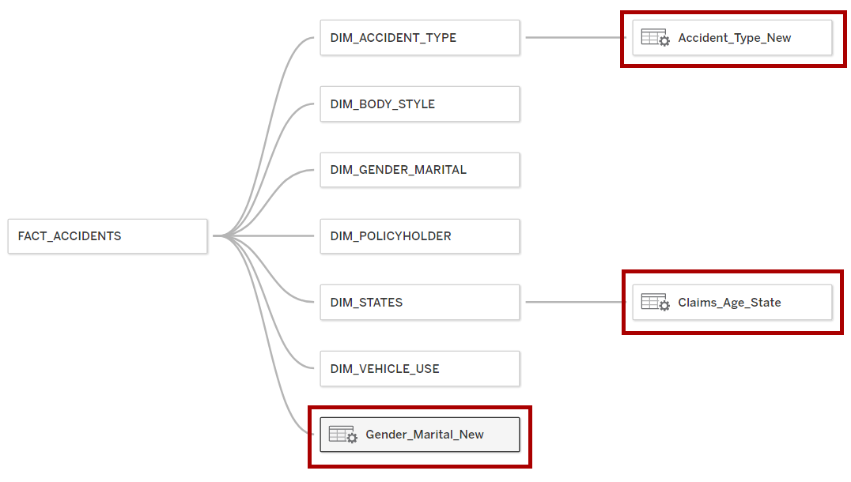
Data Cleanup Notes and Anomalies:

Slide 5
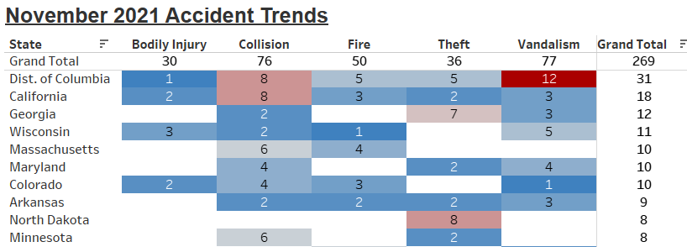
Claims Time Analysis:
Dataset spans the timeframe 1/1/2019 through 11/1/2023
November 2021 stuck out as an outlier for peak accidents
Further analysis showed the primary drivers were Collision and Vandalism losses.
California and DC had the most overall losses.

Slide 6
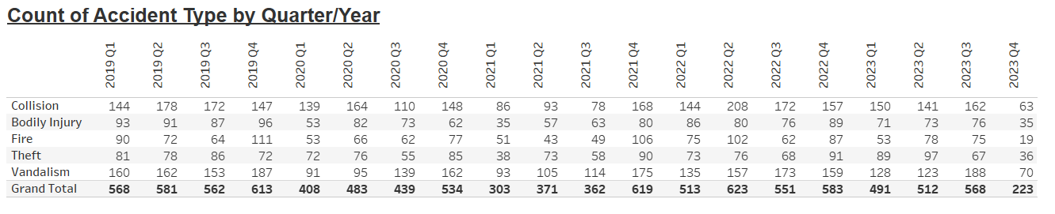
Claims Time Analysis:
Monthly and Quarterly accident trends are very “jagged”
Every other month/quarter, the trend appears to reverse.
This is consistent across accident types.
Every loss type decreased in 2020, however 2021 had 209 fewer accidents than 2020.
Collision claims increased 146% between the years 2021 and 2022.

Slide 7
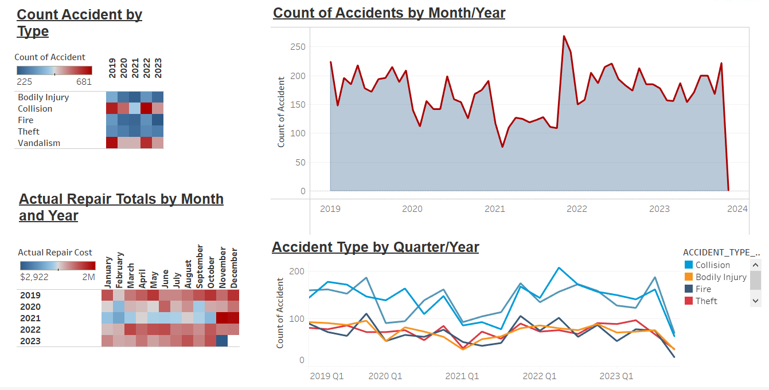
Dashboard #1 – Trend Overview

Slide 8
Statewide Analysis:
CA has largest dollar amount paid in Claim settlements and also the youngest average age (26.)
WV has largest discrepancy between claim estimate and final cost.
DC has highest DUI count and 2nd youngest average age (28.)

Slide 9
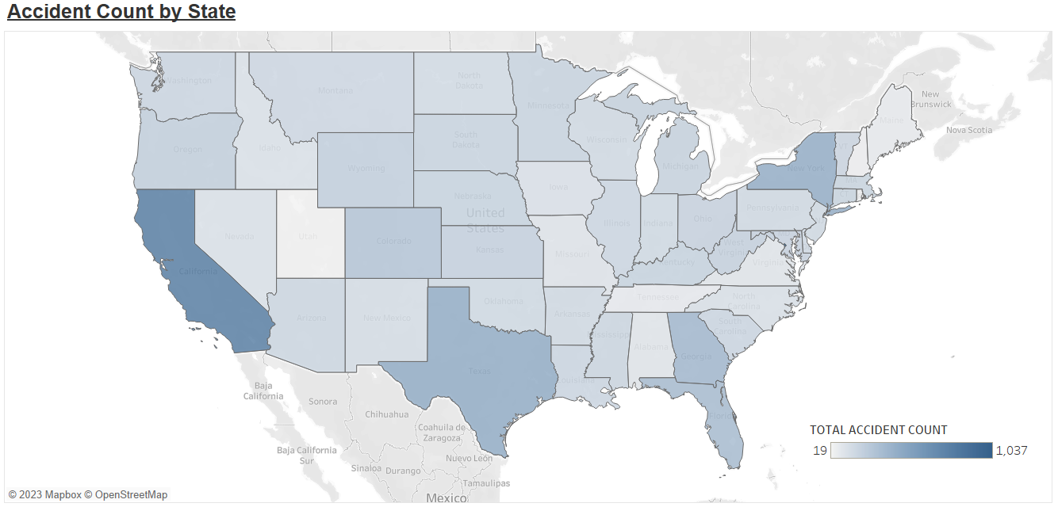
Dashboard #2 – Geographical Distribution of Accidents

Slide 10
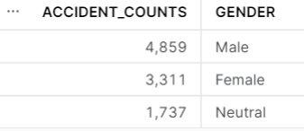
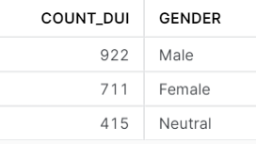
Policyholder Analysis:
Minimum age = 18
Maximum age = 60
Average age = 35
Gender/Marital Analysis:
Males account for 45% of accidents and 49% of DUI.
Approx. 20% of accidents and DUI are attributed to a “Neutral” gender marker per the dataset.

Slide 11
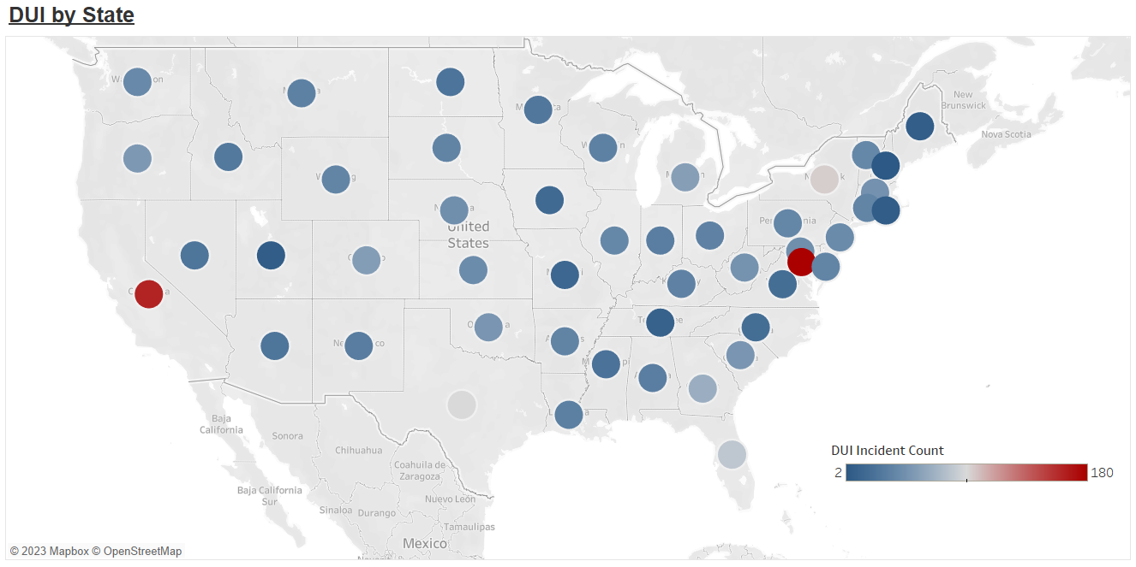
Dashboard #3 – States with highest DUI related Accidents

Slide 12
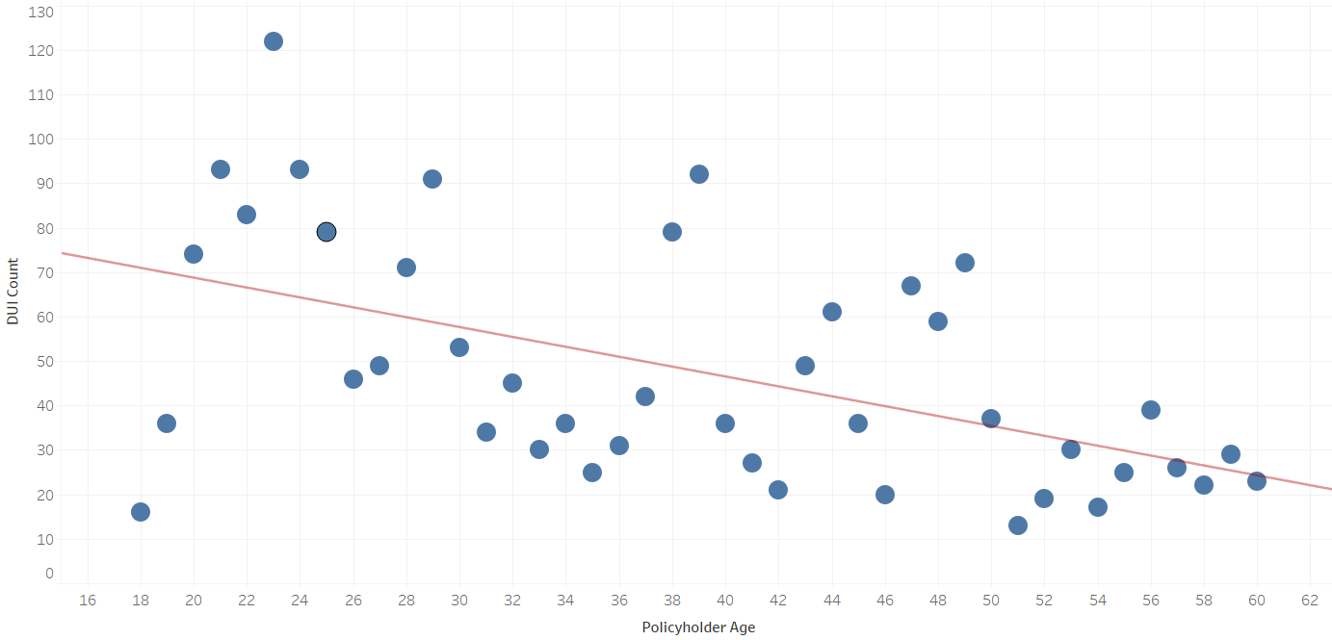

Policyholder Analysis:
I further analyzed the DUI age trend, as the 2 highest DUI states also had the lowest average ages.
Testing the hypothesis that younger drivers were more prone to DUI, the resulting scatterplot returned a statistically significant P-value, indicating that age and DUI count is related.

Slide 13
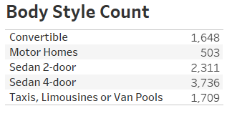
Vehicle Analysis:
Only 5 body styles are used Convertible, Motorhome, Sedan, and Taxi/Limo/Van Pool
Sedans make up 61% of total vehicles in dataset
Accident type by body style

Slide 14
Repair Discrepancies Deep-Dive
Dataset included information on Estimated Repair costs and Actual Repair costs.
In exploring this further, I wanted to pursue any trends among repair cost discrepancies
Upon calculating a field for Repair Discrepancies (Sum and Average), noticed that West Virginia and District of Columbia were significant outliers in this area.
West Virginia had the highest AVERAGE discrepancy ($1,909) and District of Columbia had the highest TOTAL discrepancies ($1,699,641.)
Created dashboard to visualize these discrepancies.

Slide 15
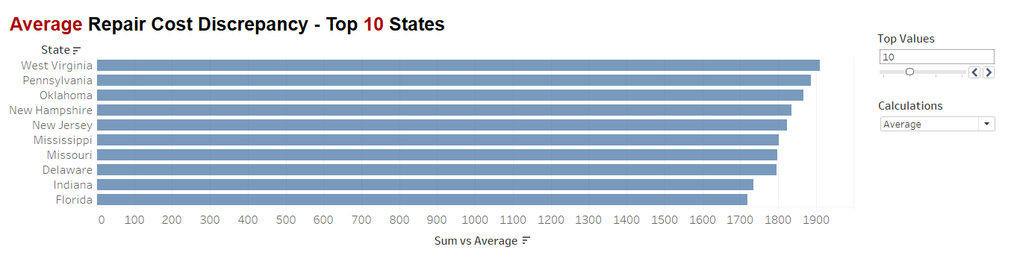
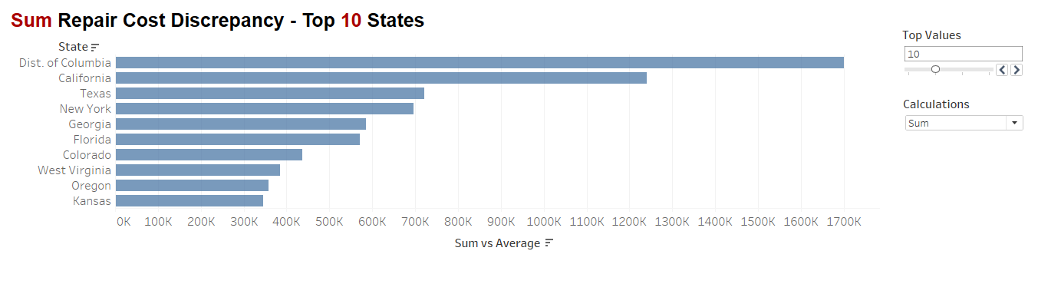
Dashboard #4 – Sum and Average Settlement Discrepancy

Slide 16
Summary
Initial dataset had a few anomalies and required some cleaning, but after some discussion with my stakeholders and SMEs, I was able to resolve.
Younger drivers are prone to DUI. Perhaps look into some sort of education program for younger drivers – especially around DUI. Propose a driver education credit.
DC and West Virginia have the highest discrepancies in estimates vs. payout.
DC appears to be an outlier on many different factors. Perhaps we need to consider the drivers for this, and given it is such a small geographical area, perhaps consider a moratorium on writing new business in this area.

Slide 17
Q&A

